Slide 1
Open AN ITALIAN RESTAURANT IN TORONTO
Sixuan zhu
September 19th, 2020

Slide 2
Introduction
Toronto, the capital of the province of Ontario, is a major Canadian city along Lake Ontario’s northwestern shore.
It's a dynamic metropolis with a core of soaring skyscrapers, all dwarfed by the iconic, free-standing CN Tower, and a various selection of global cuisine restaurants.
Sam Xiong is looking to open a new Italian restaurant in Toronto City.

Slide 3
Data acquisition and cleaning
Two main data sources for this project would be Toronto neighborhood data and Foursquare location data.
For the Toronto neighborhood data, a Wikipedia page exists that has all the information we need to explore and cluster the neighborhoods in Toronto.
Foursquare is the location data provider that share information about businesses and attractions around a certain a location point. We will need to retrieve Foursquare location data around Toronto City through API.

Slide 4
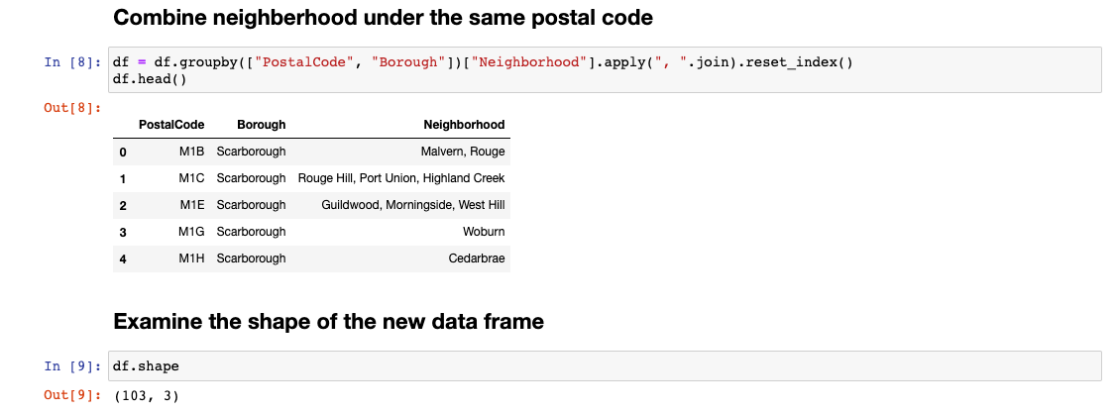
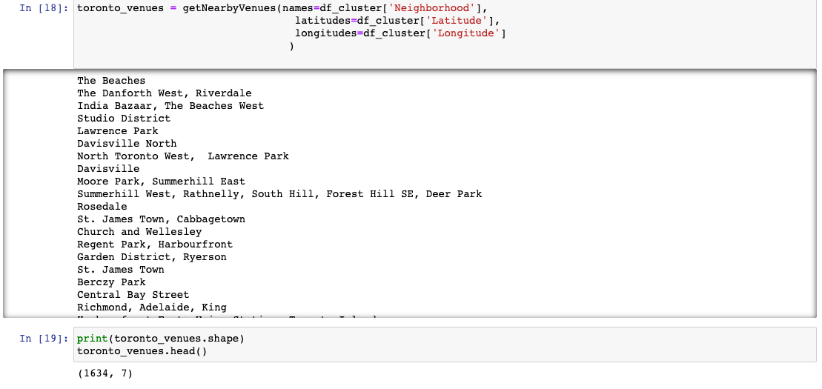
Exploratory Analysis
There are in total 103 neighborhoods and1634 venues returned from the Wikipedia Page and Foursqaure API

Slide 5
K-means clustering Analysis
K-means clustering machine learning algorithm is used to group neighborhoods with similar characteristics together, and thus help us to identify neighborhoods with many commercial venues such as park, café, restaurants, etc, which will be suitable for Sam to open a Italian restaurant.

Slide 6
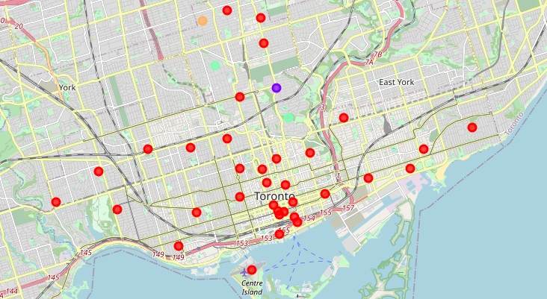
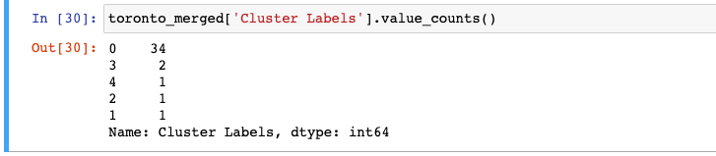
K-means CLUSTERING ANSLYSIS
There are five clusters identified with a main cluster with 34 neighborhoods in it and all the other clusters as niche clusters with 1 or 2 neighborhood in it.

Slide 7
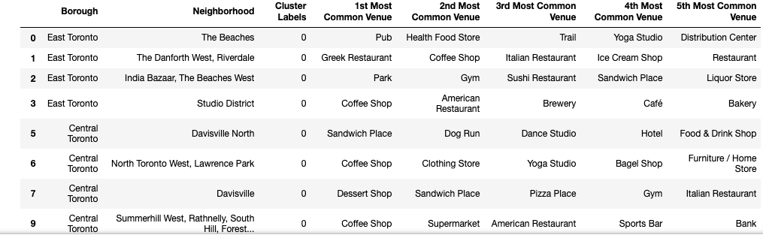
Results
After a closer investigation, I have noted that neighborhoods in cluster 0 are mostly commercial areas with a lot of restaurants, bars, parks, coffee shops, cafes, etc. It would probably be a good candidate for opening a new restaurant.

Slide 8
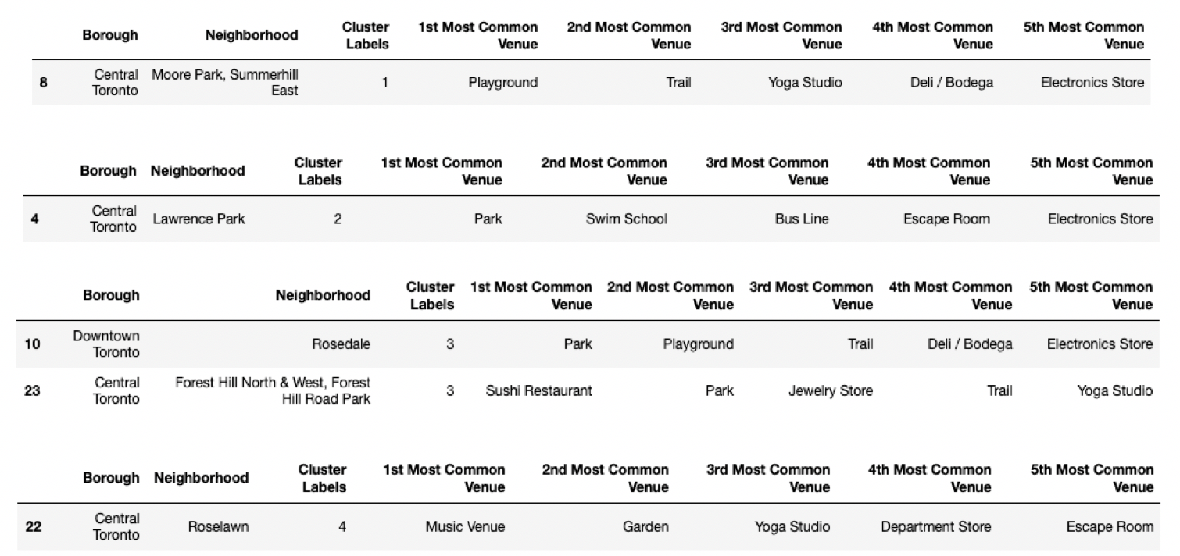
Results
Restaurants are in general not popular in 1,2,3,4 clusters Some popular venues in these clusters are department stores, swim schools, music venues, playgrounds, etc.

Slide 9
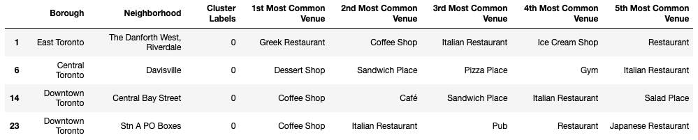
Discussions
Within cluster 0, I have found below 4 neighborhoods where Italian restaurants are one of the Top 5 most common venues:

Slide 10
Conclusions
The best candidate to open a new Italian restaurant would be among these four neighborhoods:
The Danforth West Riverdale
Davisville
Central Bay Street
Stn A PO boxes

